Slide 1
March, 2020
EHS
Novel Coronavirus (COVID-2019)

Slide 2
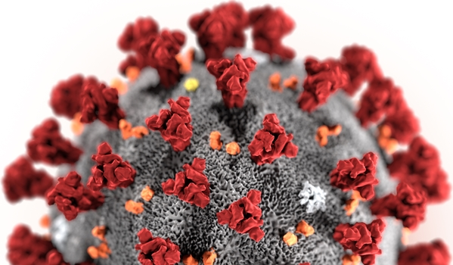
What is 2019 Novel Coronavirus?
Coronaviruses (CoV) are a large family of viruses that cause illness ranging from the common cold to more severe diseases such as Middle East Respiratory Syndrome (MERS-CoV) and Severe Acute Respiratory Syndrome (SARS-CoV).
A novel coronavirus (nCoV) is a new strain that has not been previously identified in humans like the COVID-2019*.
Source: https://www.who.int/health-topics/coronavirus
* In February 11th, 2020, the World Health Organization named the virus as COVID-19.
Notes:
On 31 December 2019, WHO was alerted to several cases of pneumonia in Wuhan City, Hubei Province of China. The virus did not match any other known virus. This raised concern because when a virus is new, we do not know how it affects people.
One week later, on 7 January, Chinese authorities confirmed that they had identified a new virus. The new virus is a coronavirus, which is a family of viruses that include the common cold, and viruses such as Severe Acute Respiratory Syndrome (SARS-CoV) and Middle East Respiratory Syndrome (MERS-CoV) . This new virus was temporarily named “COVID-2019.”
WHO has been working with Chinese authorities and global experts from the day we were informed, to learn more about the virus, how it affects the people who are sick with it, how they can be treated, and what countries can do to respond.
Because this is a coronavirus, which usually causes respiratory illness, WHO has advice to people on how to protect themselves and those around them from getting the disease.

Slide 3
What is 2019 Novel Coronavirus?
Transmission
Detection
Process for suspected case
Symptoms
Prevention

Slide 4
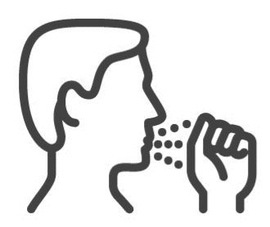
Transmission - How COVID-2019 spreads?
Coronaviruses are a large family of viruses that are common in many different species of animals, including camels, cattle, cats, and bats. Rarely, animal coronaviruses can infect people and then spread between people.
When person-to-person spread has occurred with MERS and SARS, it is thought to have happened mainly via respiratory droplets produced when an infected person coughs or sneezes, similar to how influenza and other respiratory pathogens spread. Spread of other similar viruses between people has generally occurred between close contacts.
Close contact is defined as 2m (6ft) or less without a mask.
Notes:
It’s important to note that how easily a virus spreads person-to-person can vary. Some viruses are highly contagious (like measles), while other viruses are less so. It’s important to know this in order to better understand the risk associated with this virus. While Centers for Disease Control and Prevention (CDC) considers this is a very serious public health threat, based on current information, the immediate health risk from COVID-2019 to the general American public is considered low at this time.
There is much more to learn about the transmissibility, severity, and other features associated with COVID-2019 and investigations are ongoing. The latest situation summary updates are available on CDC’s web page 2019 Novel Coronavirus, Wuhan, China.

Slide 5
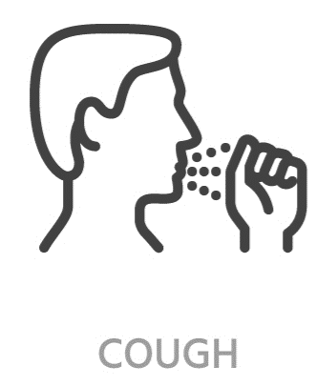
Symptoms
For confirmed COVID-2019 infections, reported illnesses have ranged from infected people with little to no symptoms to people being severely ill and dying.
Symptoms are similar to flu and can include:
Fever
Cough
Sore throat
Shortness of breath
Average life expectancy of the virus outside a person or animal is estimated as 3 hours in a dry environment and several days in wet conditions.
Notes:
Centers for Disease, Control and Prevention, believes at this time that symptoms of COVID-2019 may appear in as few as 2 days or as long as 21 after exposure. This is based on what has been seen previously as the incubation period of MERS viruses.

Slide 6
Aptiv’s level of preparedness TOGETHER WE CAN PROTECT OURSELVES, OUR TEAMS AND OUR FAMILIES
1. PREPARATORY
2. CAUTIONARY
3. SERIOUS
4. SEVERE
AWARENESS & MONITORING
ACTIONS IN PLACE
MANDATORY ACTIONS
CLOSURE
Understand the situation
Practice good hygiene measures
Join communication channels
Be prepared
Practice good hygiene measures
Make use of available PPE when needed
Report any suspected illness
Practice good hygiene measures
Support and comply with mandatory controls
Report any suspected illness
Comply with local quarantine rules
2019-nCoV | February 2020| Aptiv Confidential

Slide 7
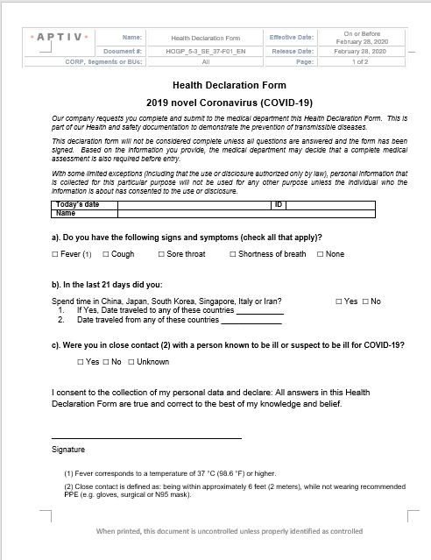
Detection
If you have fever, cough and difficulty breathing seek medical care early and share previous travel history with your health care provider.
All visitors, 3rd Party Contractors and Suppliers must be monitored previous access to the building, and refuse entry when symptoms are detected.
Fill out the Health Declaration Form is part of entrance registration. It is required, previous access to the building.
Go to EOS Corp Library
Notes:
Health Declaration Form HOGP_5-3_SE_37-F01_EN

Slide 8
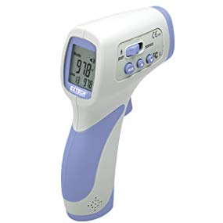
Detection TEMPERATURE CHECK
Before taking a temperature, ensure the forehead is free of perspirations and that hair has been moved aside.
With the thermometer about 5 - 8 cm (2 - 3 inches), or about 3 fingers width away from the forehead, press the SCAN button. The temperature is displayed instantly.
Please review thermometer manufacture manual for more details
Important instructions may vary between thermometers
Notes:
Normal Body Temperature
Body temperature is a characteristic of a person's metabolic condition and therefore an indication of health. Traditionally, an oral temperature of 37°
/ 98.6 ° has been considered “normal” body temperature.
Body temperature is individual to the person and can vary on a healthy person by more than +/- 1°C from 37 °C (98.6°F). Your body temperature is influenced by many factors including but not limited to the time of day, gender, age, ambient temperature and metabolic activity.

Slide 9
Detection TEMPERATURE CHECK
The patient must not have undertaken vigorous physical activity prior to temperature measurement. Also the room temperature should be moderate 10°C to 40 °C (50°F - 104°F).
Allow a 5 seconds interval between temperature measurements.
The reliability of body temperature measurement cannot be guaranteed if measured over another part of the body (i.e. arm, torso, behind ear, etc.)
Please review thermometer manufacture manual for more details
Important instructions may vary between thermometers
Notes:
Because heat loss from various parts of the body that are not covered by clothing, the normal temperature measured on a person’s forehead Is usually lower than covered parts of the body.
The reliability of body temperature measurement cannot be guaranteed if measured over another part of the body (i.e. arm, torso, behind ear, etc.)

Slide 10
Detection TEMPERATURE CHECK
Normal Body Temperatures and Age
Age | Fahrenheit | Celsius
0 – 2 years | 97.5°F – 100.4°F | 36.4°C – 38.0°C
3 to 10 years | 97.0°F – 100.0°F | 36.1°C – 37.8°C
11 to 65 years | 96.6°F – 99.7°F | 35.9°C – 37.6°C
65 years and older | 96.4°F – 99.5°F | 35.8°C – 37.5°C
Anyone with a temperature at or above 37°C must undergo additional screening before allowing access
Notes:
The patient must not have undertaken vigorous physical activity prior to temperature measurement. Also the room temperature should be moderate 10°C to 40 °C (50°F - 104°F).
Allow a 5 seconds interval between temperature measurements.

Slide 11
Prevention
There is currently no vaccine to prevent COVID-2019 infection.
The best way to prevent infection is to avoid being exposed to this virus.
If you are experiencing any cold or flu-like symptoms such as a cough, runny nose, headache or fever please seek medical help, inform your manager, and work from home. If it will not be feasible to work from home, please discuss with your manager.

Slide 12
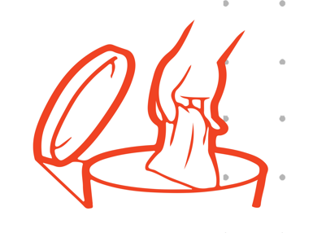
Prevention
Everyday preventive actions to help prevent the spread of respiratory viruses, including:
Wash your hands often with soap and water for at least 20 seconds. If soap and water are not available, use an alcohol-based hand sanitizer.
When coughing and sneezing cover mouth and nose with flexed elbow or tissue – throw tissue away immediately and wash hands;
Avoid touching your eyes, nose, and mouth with unwashed hands.
Avoid close contact* with anyone who has fever and cough.
* Close contact is defined as: being within approximately 6 feet (2 meters), while not wearing recommended PPE (e.g. gloves, surgical or N95 mask).

Slide 13
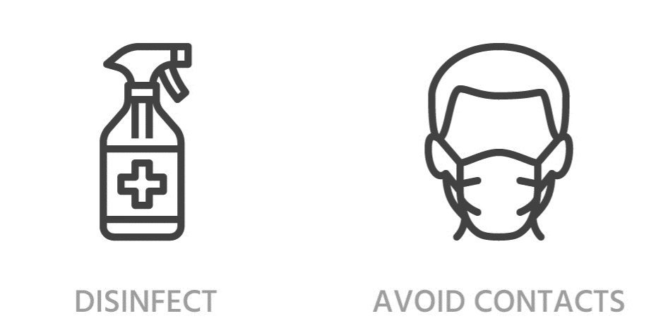
Prevention
Clean and disinfect frequently touched objects and surfaces, for this activity, use approved chemical products in your facility.
If you have fever, cough and difficulty breathing seek medical care early and share previous travel history with your health care provider;
When visiting live markets in areas currently experiencing cases of novel coronavirus, avoid direct unprotected contact with live animals and surfaces in contact with animals;
The consumption of raw or undercooked animal products should be avoided. Raw meat, milk or animal organs should be handled with care, to avoid cross-contamination with uncooked foods, as per good food safety practices.

Slide 14
Prevention – PPE
The usage of Personal Protective Equipment will be determined by the level of contingency declared in your site.
Level 1- Preparatory | Level 2 - Cautionary | Level 3 - Serious | Level 4 - Severe
Purchase masks (Surgical and/or N95) and disposable gloves. Make hand sanitizers available through the site. | Purchase and make available masks, (Surgical and/or N95), hand sanitizers and disposable gloves. Procure 3 working weeks of masks. | Provide a mask to each employee and replace daily and/or per shift. Mandatory/compulsory to wear masks. Disposable gloves for the medical area and/or emergency response team. Keep a 2m distance among employees in cafeteria and smoking area. | Site closed
Prepare to dispose masks and gloves as biological waste. | Dispose used masks and gloves as biological waste. | Dispose used masks and gloves as biological waste.

Slide 15
Treatment
There is no specific antiviral treatment recommended for COVID-2019 infection.
People infected with COVID-2019 should receive supportive care to help relieve symptoms.
For severe cases, treatment should include care to support vital organ functions. People who think they may have been exposed to COVID-2019 should contact your healthcare provider immediately.

Slide 16
Travel Notices - Business
We have a global travel ban in place for all domestic and international air-travel and it will continue this until further notice. This applies equally to all Aptiv employees as well as contingent and contract employees doing business for and on behalf of Aptiv.
These actions will help protect not only our employees, our customers, and our suppliers, but also our communities. For their sake as well as your own, We ask that you continue to use good judgement.
Essential business travel must be authorized by a member of the Executive Management Team.
Travel must be booked through BCD with the required authorization.
It is important that you adhere to this policy. This is very important for your safety and security as your booking is linked to International SOS and in an emergency, we will be able to contact you with ease. Booking your travel outside of BCD is not permitted as we have no way of centrally knowing that you are travelling, where you are travelling and would not be able to act accordingly in an emergency situation.

Slide 17
Travel Notices – Personal travels
If you (or any of your close friends or family) have visited any of the countries with a case of COVID-2019, in the last three weeks - you need to notify Human Resources immediately.
If you are arriving from a trip to these countries, contact Human Resources before going to work.
If you are planning a personal visit to any of the above countries, you also need to notify Human Resource so they can agree on the necessary steps for your return to work.

Slide 18
Travel Notices – Re-entry
Applies to all employees, contractors and contingent workers that are conducting essential approved business travel and all personal travel.
If you have travelled to a high-risk area or have been in contact with someone with COVID-19, please stay at home, self-quarantine for 14 days, seek medical attention and inform your Manager.
If you have taken any air travel (external to high-risk areas) and are experiencing flu-like symptoms, please stay at home, self-quarantine for 14 days, seek medical attention and inform your Manager.
If you have taken any air travel (external to high-risk areas) and have no symptoms, please contact your manager before you re-enter the office to assess if you should self-quarantine.

Slide 19
What can travelers do to protect themselves and others?
If you must travel for personal reasons:
Avoid contact with sick people.
Discuss travel with your healthcare provider. Older adults and travelers with underlying health issues may be at risk for more severe disease.
Avoid animals (alive or dead), animal markets, and products that come from animals (such as uncooked meat).
Wash hands often with soap and water for at least 20 seconds.
Use an alcohol-based hand sanitizer if soap and water are not available.
It’s recommended avoiding non essential travels

Slide 20
When someone suspects to be infected
If you were in China, South Korea, Japan, Singapore and Italy or in any high risk area in the last 21 days and feel sick with fever, cough, or difficulty breathing, you should:
Seek medical care right away. Before you go to a doctor’s office or emergency room, call ahead and tell them about your recent travel and your symptoms.
Notify HR
Avoid contact with others.
Not travel while sick.
Cover your mouth and nose with a tissue or your sleeve (not your hands) when coughing or sneezing.
Wash hands often with soap and water for at least 20 seconds. Use an alcohol-based hand sanitizer if soap and water are not available.

Slide 21
Suspected Infected People Procedure Steps Criteria to evaluate employees and take appropriate action
Symptoms & risks
Fever* and symptoms of respiratory illness (e.g., cough, difficulty breathing)
and
In the last 21 days before symptoms appeared, a history of travel to any high risk area. or In the last 21 days before symptoms appeared, close contact ** with a person who has been in a high risk area
Actions
Upon detecting personnel with signs and symptoms, the supervisor or manager will contact site Doctor/Nurse or send personnel to external medical facilities.
Quarantine at home for 21 days employees that present symptoms, employees that have recently traveled to a high risk area, and those that have been in close contact** with someone with symptoms.
* Fever corresponds to a temperature of 37 °C (98.6 °F) or higher. ** Close contact is defined as: being within approximately 6 feet (2 meters), while not wearing recommended PPE (e.g. gloves, surgical or N95 mask)

Slide 22
Thank you.

